Slide 1
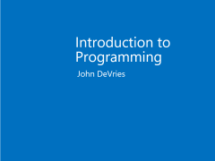
Introduction to Programming
John DeVries

Slide 2
Modern Programming Languages
Object Orientation
Functions (Methods)
Code Libraries
Event-Driven Architecture
Complex Types
Properties (encapsulation)
Namespaces
Inheritance
Overloading (polymorphism)
Identifier collision prevention
Reusability
Capture user input
Interfaces
Decoupled Code
Interfaces
Dependency injection

Slide 3
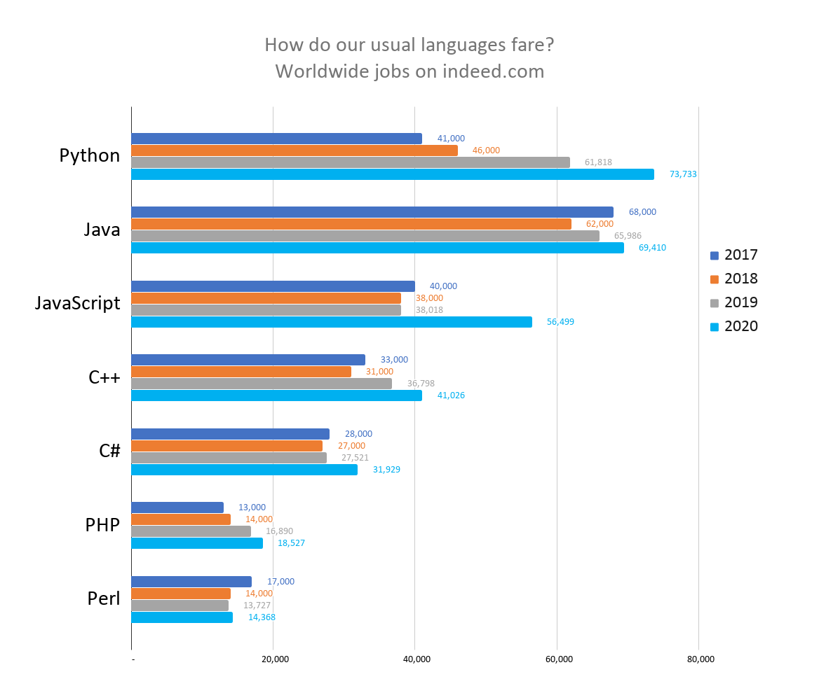
Programming Languages

Slide 4

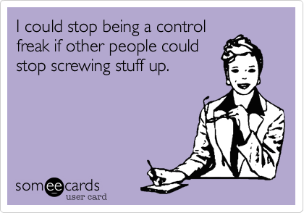
Foundations of Good Programming
Absolute Control!!

Slide 5
.Net System
Managed Code
Build/Compile
Intermediate Language
C#
Machine Code
Visual Basic
CLR
F#
Assembly
(.dll or .exe)
Unmanaged Code
Other Compiled Code

Slide 6
Understanding an application
High-level organization
(OOP, classes, properties, methods)
Low-level details
(variables, functions, branching, looping)
Tools
Code editing
Source Code Control
PROGRAM

Slide 7
Parts of the .Net system
Class Libraries
.Net
Tools
Visual Studio
Visual Studio Code
Programming Language
C#

Slide 8
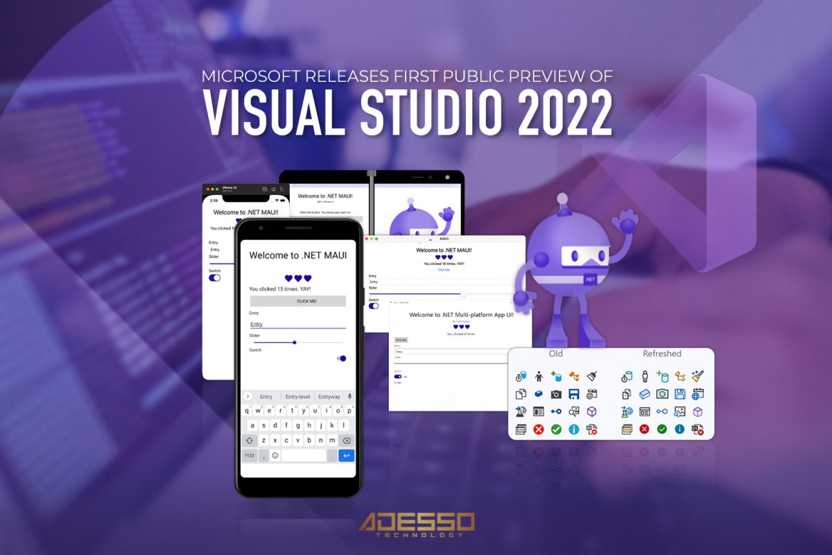
Visual Studio

Slide 9
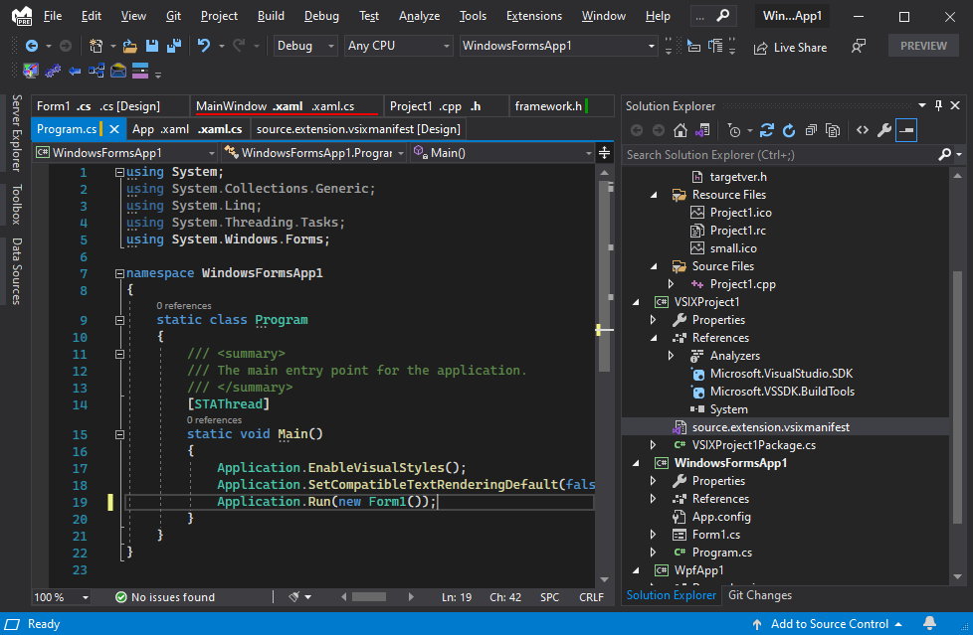
Visual Studio

Slide 10
VS Build Process
Save All
Build (compile) code
Load app on IIS Express (MS Web Server) and assign port
Opens browser and goes to localhost:port for app
Visual Studio
Start with or without debug

Slide 11
Elements of a program
Ways to represent data in memory
Ways to manipulate data in memory
Ways to show data and actions to users
Ways to persist data outside of memory

Slide 12
Elements of a program
Ways to represent data in memory
Ways to manipulate data in memory
Ways to show data and actions to users
Ways to persist data outside of memory
Variables and Constants
Operators and Expressions
User Interface Framework
Files and Databases
Data Types

Slide 13
Elements of a program
Ways to represent data in memory
Ways to manipulate data in memory
Ways to show data and actions to users
Ways to persist data outside of memory
Variables and Constants
Operations and Expressions
User Interface Framework
Files and Databases
Data Types

Slide 14
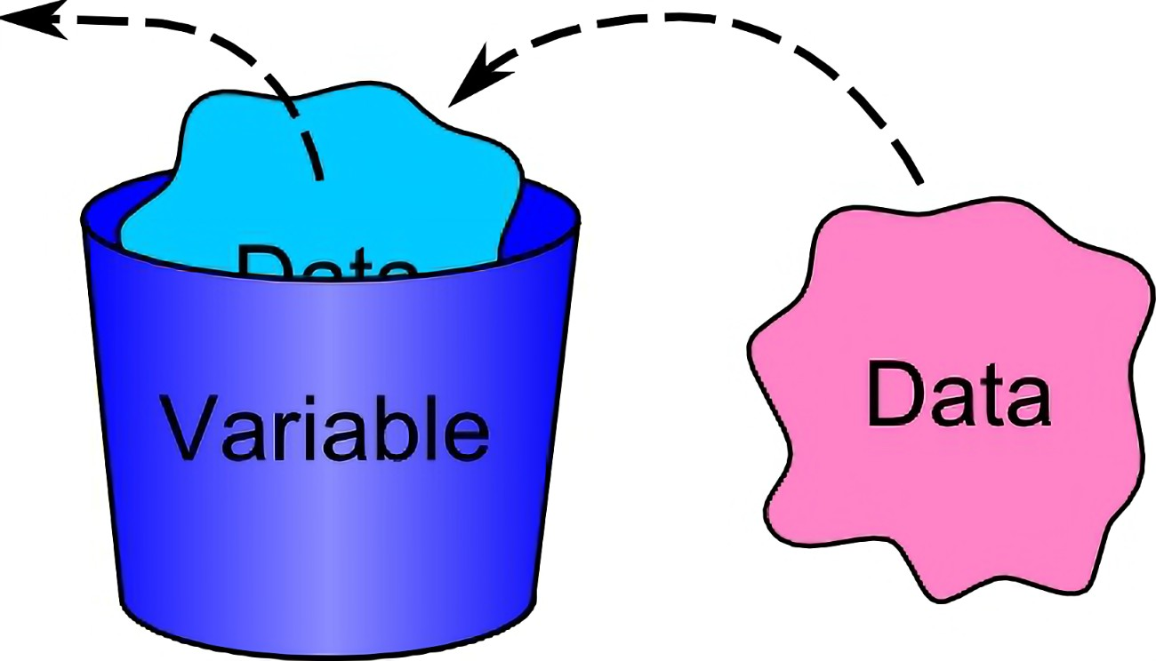
Variables and Constants

Slide 15
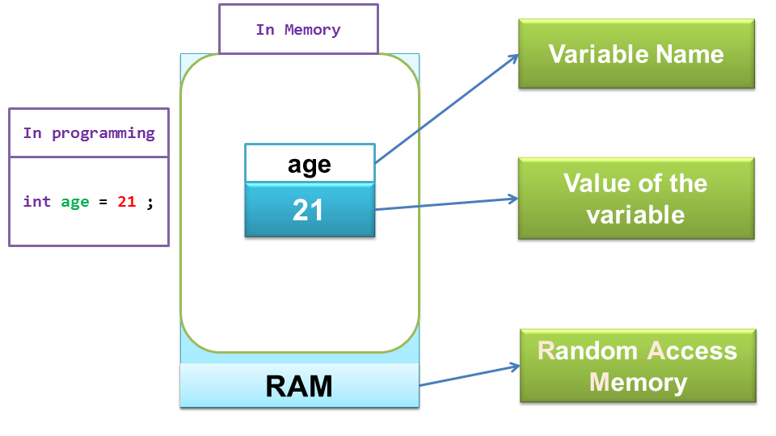
Variables and Constants

Slide 16
Casing Conventions
myNum - camel case
MyProp - Pascal case

Slide 17
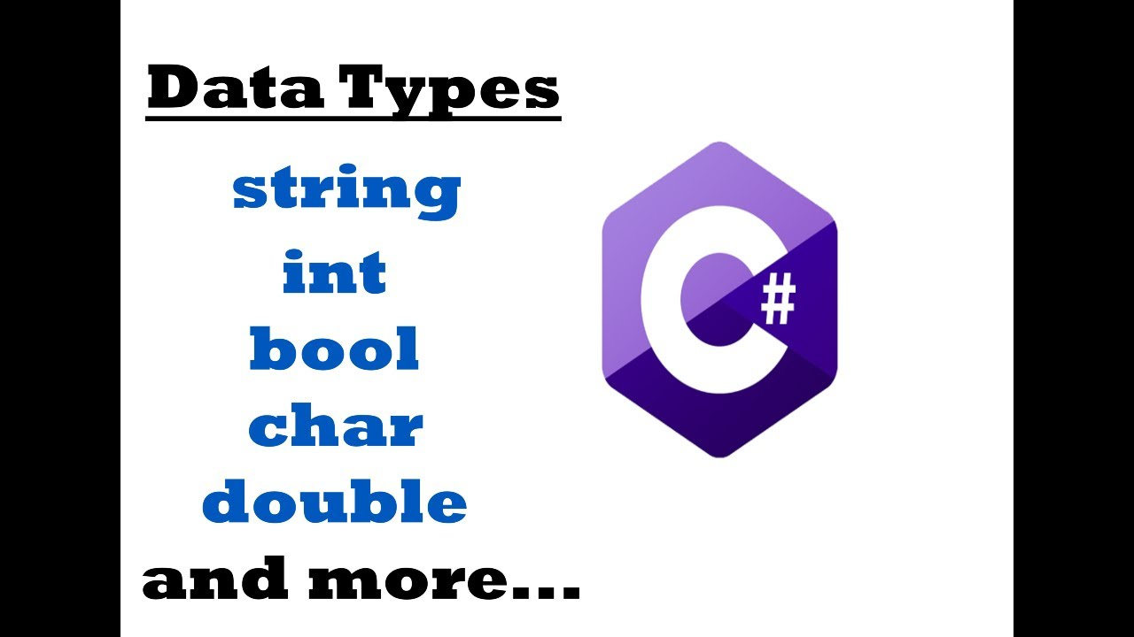
Data Types

Slide 18
Choosing a Data Type
DO NOT choose a type to save memory
Literally not worth your time
DO choose a type to prevent errors
e.g. Use an unsigned int to store age
uint age = 35

Slide 19
Elements of a program
Ways to represent data in memory
Ways to manipulate data in memory
Ways to show data and actions to users
Ways to persist data outside of memory
Variables and Constants
Operators and Expressions
User Interface Framework
Files and Databases
Data Types

Slide 20
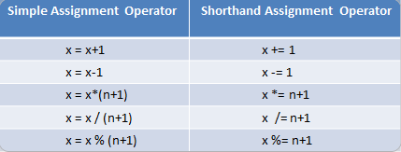
Assignment Operator
The “=“ means assignment, not equality
Assignment should be read from right to left
Shorthand assignment operators rarely used in modern code
Int age = 35

Slide 21
Evaluating an Assignment
int x = 2;
int x = y;
int x = x+y;

Slide 22
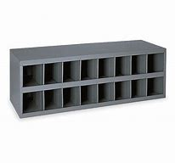
Variables in memory
2
X
3
Y

Slide 23
Variables in memory
5
X
3
Y
x = x + y
x = 2 + 3
x = 5

Slide 24
C# Operators
Category | Operators
Arithmetic | + - * / %
Relational | == != < <= > >=
Logical | ! && ||

Slide 25
Expressions
Expression == Data + Operators
May evaluate to any data type
Condition is a type of Expression
May only evaluate to a Boolean (true or false)
int num0fThings = someThings + otherThings
int num0fThings == someThings + otherThings

Slide 26
Flow – The thread of execution
Step 1
Step 2
Step 3
Begin thread of execution

Slide 27
Branch
Step 4a
Step 5a
Step 6a
…
Step 1
Step 2
Step 3
TRUE
CONDITION
Step 4b
Step 5b
Step 6b
…
FALSE

Slide 28
Loop
Step 1
Step 2
Step 3
Step 4
Step 5
…
FALSE
Test Loop Condition
Loop Step 1
Loop Step 2
Loop Step 3
Loop Step 4
TRUE

Slide 29

Software Architecture – Organizing Your Code
The goal is Maintainability
Findability
If you can’t find it, you can’t fix or modify it

Slide 30
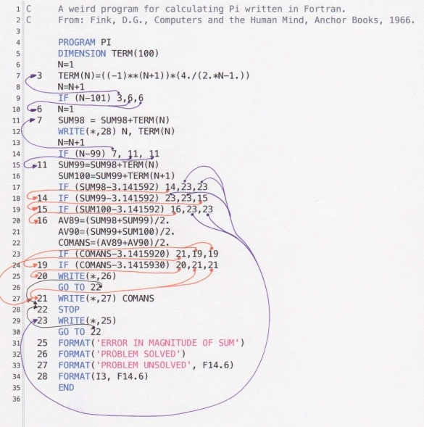
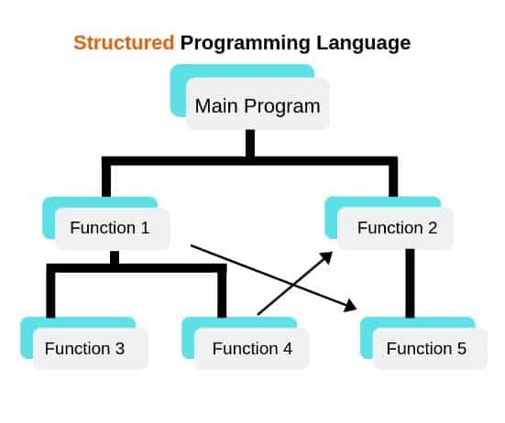
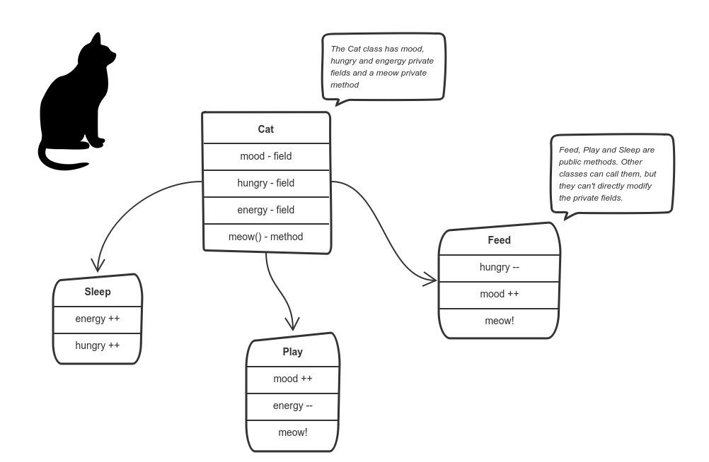
Evolution of Programming Architectures
Unstructured (spaghetti code)
Structured (functions)
Object Oriented (objects)

Slide 31
Stages of Programming
Stage 1 – Simple programming
All code in a single block
Stage 2 – Structured programming
Code is broken functional blocks, each with a specific job and a name
Call a function when you need to do that task
Stage 3 – Object Oriented Programming
Organize data and actions around the real-world object that the code is manipulating

Slide 32
Functions
A Method is a Function inside of a Class
In C#, all functions are Methods
Definition of method
MethodName(param1, param2, …)
Value in program
Using method
MethodName(argument1, argument2, …)

Slide 33
Method in Use
Definition of method
SetAppointment(owner, datetime, …)
Value in program
Value in program
Using method
SetAppoint(DeVries, 7/7/2020, …)

Slide 34
Flow – The thread of execution
Step 1
Step 2
Step 3
Begin thread of execution
x
Void
Method a
Type of x
Method b
Return x

Slide 35
Arrays
string[5] cars;
Subaru | Mazda | Ford | GMC | Toyota
cars[0]
[1]
[2]
[3]
[4]
To add a sixth element:
Create a new array of proper size
Copy elements from old array
Add new elements
Subaru | Mazda | Ford | GMC | Toyota
Subaru | Mazda | Ford | GMC | Toyota | Honda

Slide 36
Reverse an Array
1
2
3
4
5
6
7
8
0
1
2
3
4
5
6
7
Temp =
1
8
7
6
5
4
3
2
1
8
“Length” is number of elements in array
Loop will repeat Length/2 times

Slide 37
Reverse an Array
For (i = 0; i < n/2; i++)
i
(n-1)-i)
1
2
3
4
5
6
7
8
0
1
2
3
4
5
6
7
Temp =
1
8
7
6
5
4
3
2
1
8
n =“Length” is number of elements in array
Index of last element is n-1
Loop should repeat n/2 times

Slide 38
Collections
Used to hold groups of data items of the same type
List
Dictionary
Value
Key
Value
3
Monday
3
5
Tuesday
5

Slide 39
Object Oriented Programming

Slide 40
Passing data to a method using variables
public void UpdateUserInfo(int id, string username, string firstName, string lastName, string addressLine1, string addressLine2, string addressLine3, string addressLine3, string addressLine4, string city, string postcode, string region, string country, string homePhone, string workPhone, string mobilePhone, string personalEmail, string workEmail, string notes)
{
// ### implementation omitted ###
}

Slide 41
Define a Class
public class UserInfo
{
public int Id { get;set; }
public string Username { get; set; }
public string FirstName { get; set; }
public string LastName { get; set; }
public string AddressLine1 { get; set; }
public string AddressLine2 { get; set; }
public string AddressLine3 { get; set; }
public string AddressLine4 { get; set; }
public string City { get; set; }
public string Region { get; set; }
public string Country { get; set; }
public string HomePhone { get; set; }
public string WorkPhone { get; set; }
public string MobilePhone { get; set; }
public string PersonalEmail { get; set; }
public string WorkEmail { get; set; }
public string Notes { get; set; }
}

Slide 42
UserInfo
FirstName
LastName
Id
UserName

Slide 43
Instantiate the Class
UserInfo userInfo = new UserInfo();

Slide 44
public void UpdateUserInfo(UserInfo userInfo)
{
// ### implementation omitted ###
}
Access using dot notation
userInfo.Id
userInfo.UserName
…

Slide 45
Classes can include other Classes
Public Class Address
{
public string AddressLine1 { get; set; }
public string AddressLine2 { get; set; }
public string AddressLine3 { get; set; }
public string AddressLine4 { get; set; }
public string City { get; set; }
public string Region { get; set; }
public string Country { get; set; }
}
public class UserInfo
{
public int Id { get;set; }
public string Username { get; set; }
public string FirstName { get; set; }
public string LastName { get; set; }
public Address address {get; set;}
public string HomePhone { get; set; }
public string WorkPhone { get; set; }
public string MobilePhone { get; set; }
public string PersonalEmail { get; set; }
public string WorkEmail { get; set; }
public string Notes { get; set; }
}

Slide 46



Classes
Object (executable)
Type: Bungalow1
Constructor
Class (description)
Class Name: Bungalow1
instantiation
Properties
Methods
Constructor
Other

Slide 47
Members of a Class
Fields are local scope variables in a Class
Properties hold data in memory
We call classes that are mostly Properties “Models”
Methods perform actions on data
We call classes that are mostly Methods “Class Libraries”

Slide 48
A Sample Class
Class CreditCourse
{
int courseId;
string courseName;
int courseLength;
CreditCourse()
{
}
}

Slide 49
Instantiating a Class
Complex data type
variable
constructor
CreditCourse creditCourse = new CreditCourse();
or var
or creditCourse1
or foo
Specify data type
Of variable
Assign to
variable
Creates a new instance of class (object)

Slide 50
Class Design
Vet Practice App
Class Animal
Class Appointment
Action | Class | Method
Register new owner | Owner | CreateNewOwner
Assign a vet to a pet (optional) | Pet | AssignVet
Register pet | Pet | RegisterPet
Make an appointment | Appointment | CreateAppt
Cancel appointment | Appointment | CancelAppt
Change appointment | Appointment | ChangeAppt
Make pet inactive | Pet | MakeInactive
properties
properties
Methods
Constructor
RegisterPet
AssignVet
Methods
Constructor
CreateAppt
CancelAppt
ChangeAppt
Class
Vet
Class
Owner
properties
properties
Methods
Constructor
Methods
Constructor
CreatNewOwner

Slide 51
Typical Class
Class Properties
Complex Data Type
Class Animal
{
string PetName
string Owner
char Gender
datetime DoB
int AmountOfFood
string BloodType
list Medications[]
string Species
float Height
float Weight
bool Spayed/Neutered
}

Slide 52
Typical Class
Class Properties
Complex Data Type
Class Appointment
{
ApptId
string PetId
string OwnerId
Datetime ApptDateTime
string VetId
string Reason
}

Slide 53
Typical CRUD Method –Make Appointment
Create
Read
Update
Delete
Class Properties
Select Owner and Pet
Provide option to add Owner and Pet
Select Vet or let system show next available Vet
Select Date and Time
Select Reason for appointment
Enter Notes (optional)
Class Appointment
{
ApptId
string PetId
string OwnerId
Datetime ApptDateTime
string VetId
string Reason
}

Slide 54
Consuming a Class Library
Instantiate an Object from a Class in the Class library (Instance Class)
Define Classes and/or Methods as “static”
Static Classes and Methods are instantiated by CLR
Do not need to be instantiated, you just use them
Can have only one copy (Singleton)
Inherit the Base Class from the Class library
Extend it to customize for your application

Slide 55
Working with an external service
External Service
(File or DB or Network or …)
In-Memory Proxy for External Service
(Client or Context Object)
Your Code

Slide 56
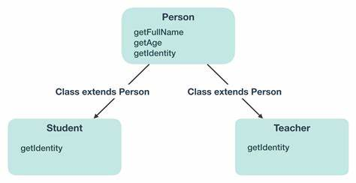
OOP - Inheritance

Slide 57
OOP - Inheritance
Dog
-Breed
Abstract Base Class
Pet
:
Cat
Reptile
-Owner
-Name
-DoB
-Weight
…
(-Species)?
Bird
Fish
- Fresh or salt water

Slide 58
OOP- Polymorphism
Overload
Override
Provide multiple methods with same name differing in parameters
Inherit Base Class, then change an inherited method
AddNums (a,b)
sum=a+b
return sum
AddNums (a,b,c)
sum=a+b+c
return sum
AddNums (a,b,c,d)
sum=a+b+c+d
return sum

Slide 59
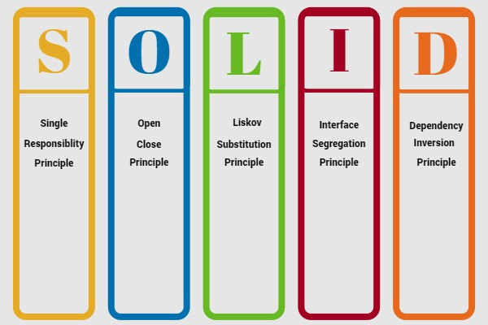
Foundations of Good Programming

Slide 60
Tightly-Coupled Architecture
Statement
method
Statement
method
method
method
Statement
Statement
Statement

Slide 61
Data Structures and Algorithms

Slide 62
Complexity Analysis
https://imgs.xkcd.com/comics/complexity_analysis.png

Slide 63
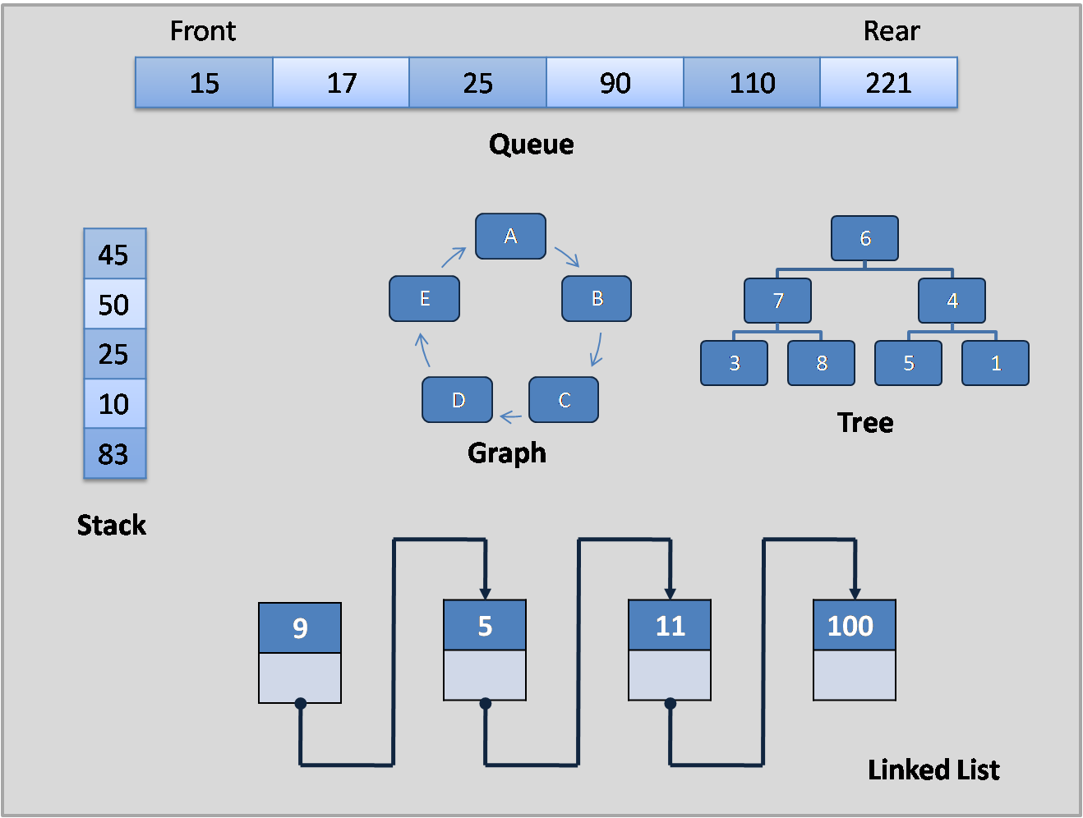
Common Data Structures

Slide 64
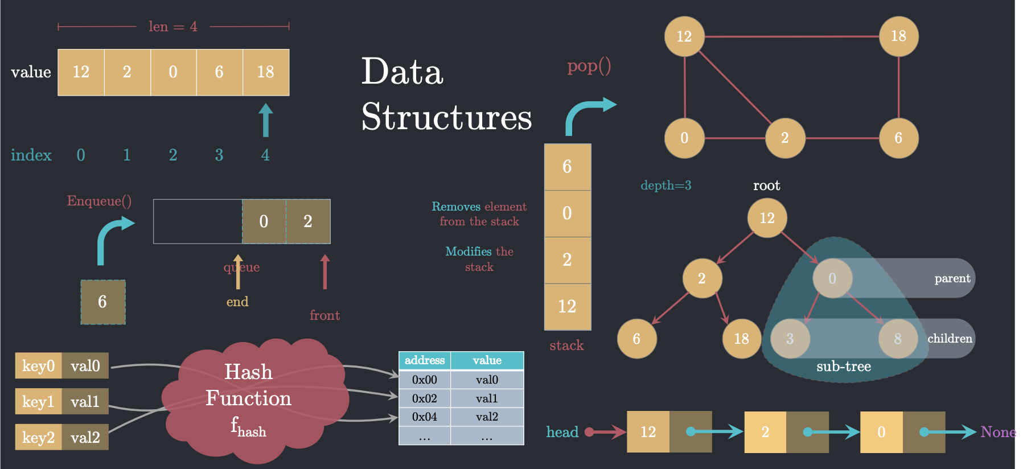
Common Data Structures

Slide 65
Array
One chunk of memory – items are contiguous
[0] | [1] | [2] | [3] | …
Val1 | Val2 | Val3 | val4
Contiguous in memory
High performance compared to more advanced collections (e.g. List, Dictionary)
Statically allocated – fixed size
Zero-based indexes
Strongly typed
Values may be any data type, including custom types defined by a Class

Slide 66
Normal Function
State
void MyFunction()
{}
State
MyFunction
Restores
State from
Stack
Stack

Slide 67
Recursive Function
State
void MyFunction()
{}
State Function 2
State Function 1
State Main
MyFunction 1
MyFunction 2
MyFunction 3
Stack

Slide 68
Lower Plot Problem – LeetCode 605
Array flowerPlots Length = l
i-1
i
i+1
1 | 0 | 0 | 1 | 0 | 0 | 0 | 1
Flowers cannot be in adjacent plots
For number n, can you plant n new flowers?

Slide 69
Stack
[…]
[5]
[4]
Value4
Everything going on at this point in thread of execution
[3]
Value3
Everything going on at this point in thread of execution
push
pop
[2]
Top =1
Value2
Everything going on at this point in thread of execution
[1]
Value1
Everything going on at this point in thread of execution
[0]
array

Slide 70
Dictionary
[…]
[5]
[4]
[3]
Key3
LastName + FirstName
User3
Info about this user
[2]
Key2
LastName + FirstName
User2
Info about this user
[1]
Key1
LastName + FirstName
User1
Info about this user
[0]
key
value
dictionary

Slide 71
Implementing a Method
Context
Everything going on at this point in thread of execution
Thread
Thread
Context
Everything going on at this point in thread of execution
Thread
Method
Context
Everything going on at this point in thread of execution
Stack

Slide 72
Implementing a Recursive Method
Context
Everything going on at this point in thread of execution
Thread
Thread
Method R1
Context R3
Everything going on at this point in thread of execution
Thread
Context R2
Everything going on at this point in thread of execution
Method R2
Context R1
Everything going on at this point in thread of execution
Context
Everything going on at this point in thread of execution
Method R3
Context R4
Everything going on at this point in thread of execution
Method R4
Stack

Slide 73
Understanding a complex conditional
For each element of the condition, create a separate variable that stores the Boolean result
Give the variable a name that reminds you what the Boolean represents
Replace the element with the new variable in the complex condition
If (i==0 && i-1 ….
bool isFirstPlot = (i== 0)
If (isFirstPlot && …

Slide 74
Class LinkedList
new LinkedList
new Node (head)
Data<T>
Next ==
Class Node
T Data
Node Next
new Node(Next)
Data<T>
Next == null

Slide 75
count = 0
For (i=0;
If (array[i] != 0
array[count++] = array[i]
i
[2,4,0,3,0,5]
count

Slide 76
Queue
end
start
0 | 1 | 2 | 3 | 4 | 5
Message1
message3
message4
message2

Slide 77
IncomingCall call = new IncomingCall();
var call = new IncomingCall();
IncomingCall call = new();

Slide 78
Rotate Matrix
90°
0,0 | 0,1 | 0,2
1,0 | 1,1 | 1,2
2,0 | 2,1 | 2,2
0,0 | 0,1 | 0,2
1,0 | 1,1 | 1,2
2,0 | 2,1 | 2,2
2,0
1,0
0,0
2,1
1,1
0,1
2,2
1,2
0,2
Index i,j

Slide 79
Rotate Matrix
90°
0,0 |  |  | 0,3
 |  |  | 3,3
 |  |  | 0,3
3,0 |  |  | 3,3
0,0 | 0,1 | 0,2
1,0 | 1,1 | 1,2
2,0 | 2,1 | 2,2
0,0 | 0,1 | 0,2
1,0 | 1,1 | 1,2
2,0 | 2,1 | 2,2
2,0
1,0
0,0
2,1
1,1
0,1
2,2
1,2
0,2
Index i,j

Slide 80
Product Except Self – LeetCode 238
Prefix
Suffix
1 | 2 | 3 | 4
index
0 | 1 | 2 | 3

Slide 81
Product Except Self – LeetCode 238
Prefix
Suffix
1 | 2 | 3 | 4
index
0 | 1 | 2 | 3
nums
int rightSide = 1;
for (int i = nums.Length - 1; i >= 0; i--)
{
result[i] = result[i] * rightSide;
rightSide *= nums[i];
}
result[0] = 1;
for (int i = 1; i < nums.Length; i++)
result[i] = result[i - 1] * nums[i - 1];
1
index
0 | 1 | 2 | 3
result

Slide 82
Reverse Entire Array
a
m
a
z
o
n
0
1
2
3
4
5
8
7
6
5
4
3
Temp =
1
“Length” is number of elements in array
Loop will repeat Length/2 times

Slide 83
Reverse Vowels Only
i
J= n-1-i
a
m
a
z
o
n
0
1
2
3
4
5
o
m
a
z
a
n
Temp =
a
n is number of elements in array
Loop will repeat n/2 times

Slide 84
Collections
Used to hold groups of data items of the same type
List
Dictionary
Value
Key
Value
3
Monday
3
5
Tuesday
5

Slide 85
Insertion Sort Sort
25
3
56
12
47
8
0
1
2
3
4
5
Temp =
“Length” is number of elements in array
Loop will repeat Length/2 times

Slide 86
Shell Sort
25
3
56
12
47
8
0
1
2
3
4
5
Temp =
“Length” is number of elements in array
Loop will repeat Length/2 times

Slide 87
Mini Project

Slide 88
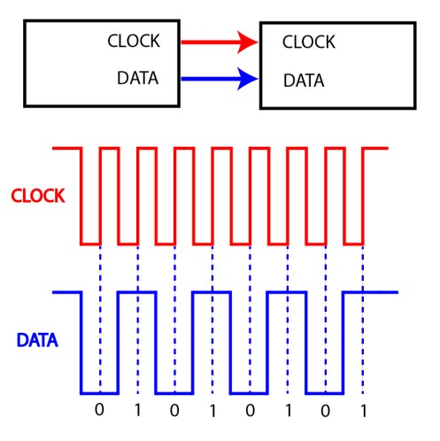
Serial Data

Slide 89
Project Instructions
Pick a real-world application
Create an outline of the solution
May be written or code outline
Implement at least a partial solution
Show enough to make overall organization clear
UI is least important element

Slide 90
Project Guidelines
May be planned as a simpler or partial version of final project Demonstrate good OOP organization
Classes, Properties, Methods, Constructors
Inheritance, overloads or overrides
Use at least one Collection (e.g. List, Dictionary, etc)
May use any UI (e.g console app, WinForms, .Net MAUI, etc)
Should take no more than 8 hours work

Slide 91
Data Persistence

Slide 92
OS:
Windows or
Linux or
MacOS
Program executing in memory
Create a file
Open a file
Read from file
Write to file
I/O
File on HDD
Code
Stream
I/O
File on SSD
I/O
File on SAN
Abstraction
I/O
File on Cloud Storage

Slide 93
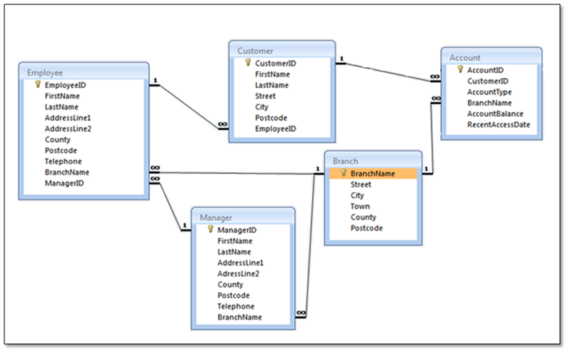
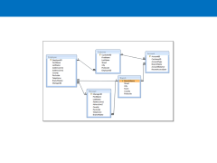

Slide 94
Class: Person
Property: ID
Property:FirstName
…
Object: Person1
Table: Person
ID | FirstName | LastName | DoB
Object: Person2
Object: Person3

Slide 95
.Net Program
Relational Database
Cache
ADO.Net
Provider
Table1
Field1
Field2
DataClass1
Prop1
Prop2
LINQ
Entity Framework
Data
Class 2

Slide 96
Program
myContext:DbContext
Database
Read
DBSet

Slide 97
Program
Your code
Database
myContext: DbContext
DBSet
SaveChanges()
Write

Slide 98
User Interface

Slide 99
Graphical User Interface (GUI)
Desktop
XAML
.Net MAUI
Web App
HTML, CSS & JavaScript
Razor
Web API
Server-to-Server
No UI needed
Blazor
JS Framework (Angular, React, Vue, etc.)
Xamarin

Slide 100
UI Issues
Dynamic Data
Data Binding
Page Composition
Create page from reusable pieces
Event Handling
Event Object
Event source
Event properties

Slide 101
Event Generator
Event Listener
Event object
Event
object
Event Handler

Slide 102
Main_entry
Method1
Method2
Method3
method4
Garbage Collector
Scope
Scope
Scope
Scope
Scope

Slide 103
Memory
Reference Type
variable
Value Type
copy
variable

Slide 104
Memory
Reference Type
Variable y
Variable x
=
Value Type
Variable
b
Variable
a
=
Another copy
copy

Slide 105
Elements of a program
Ways to represent data in memory
Ways to manipulate data in memory
Ways to show data and actions to users
Ways to persist data outside of memory
Variables and Constants
Operators and Expressions
User Interface Framework
Files and Databases
Built-in Data Types
Objects (Classes, Structs, etc.)
Properties
Custom Complex Data Types
Methods

Slide 106
Flow – The thread of execution
Step 1
Step 2
Step 3
Begin thread of execution

Slide 107
Branch
Step 4a
Step 5a
Step 6a
…
Step 1
Step 2
Step 3
TRUE
CONDITION
Step 4b
Step 5b
Step 6b
…
FALSE

Slide 108
Loop
Step 1
Step 2
Step 3
Step 4
Step 5
…
FALSE
Test Loop Condition
Loop Step 1
Loop Step 2
Loop Step 3
Loop Step 4
TRUE

Slide 109
Blocking
Step 1
Step 2 SLOW
Step 3
Begin thread of execution

Slide 110
Blocking
Begin thread of execution
Step A1
Step A2
Step A3
Begin new thread of execution
Step B1
Step B2
slow
Step B3

Slide 111
Asynchronous Programing
Async keyword in front of a class or method to cause it to execute as an asynchronous TASK.
Main thread is free to continue.
Use the Await keyword to set Callback method.

Slide 112
OOP and MVVM

Slide 113
Intro
The project architecture shown in these slides is:
.Net MAUI
MVVM
Uses the MVVM Community Toolkit

Slide 114
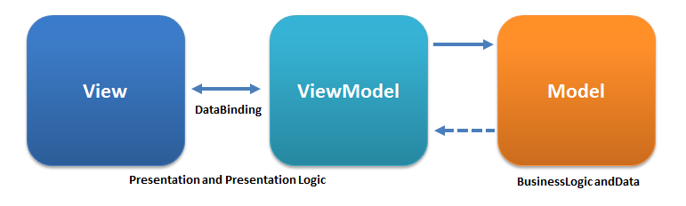
MVVM Pattern – as usually shown
Conceptually correct, but misleading about implementation

Slide 115
Model Classes in MVVM
Blueprints for POCO (Plain Old CLR) objects
Packages of properties and methods
Definitions of custom data types
Model View ViewModel

Slide 116
C# Language – Built-in keywords
If, else if, else
switch
Return
While
For
For each
Public, private, internal
New
Static

Slide 117
C# Primitive Data Types
Built-in data types
Bool
Int
Float, double
Char
string
Where do they come from?
From the system class library

Slide 118
C# Custom Data Types
Typically complex data types
Defined by a Class (pretend structs are a class)
Package includes more than one piece of information

Slide 119
Typical Custom Data Type
public class UserInfoType
{
public int Id { get;set; }
public string Username { get; set; }
public string FirstName { get; set; }
public string LastName { get; set; }
public string AddressLine1 { get; set; }
public string AddressLine2 { get; set; }
public string AddressLine3 { get; set; }
public string AddressLine4 { get; set; }
public string City { get; set; }
public string Region { get; set; }
public string Country { get; set; }
public string HomePhone { get; set; }
public string WorkPhone { get; set; }
public string MobilePhone { get; set; }
public string PersonalEmail { get; set; }
public string WorkEmail { get; set; }
public string Notes { get; set; }
}

Slide 120
Passing data to a method using variables
public void UpdateUserInfo(int id, string username, string firstName, string lastName, string addressLine1, string addressLine2, string addressLine3, string addressLine3, string addressLine4, string city, string postcode, string region, string country, string homePhone, string workPhone, string mobilePhone, string personalEmail, string workEmail, string notes)
{
// ### implementation omitted ###
}

Slide 121
Custom Data Types - Packages
public void UpdateUserInfo(UserInfoType userInfo)
{
// ### implementation omitted ###
}
Access using dot notation
UserInfo.Id
UserInfo.UserName
…

Slide 122
Class Design
Vet Practice App
Class Animal
Class Appointment
Action | Class | Method
Register new owner | Owner | CreateNewOwner
Assign a vet to a pet (optional) | Pet | AssignVet
Register pet | Pet | RegisterPet
Make an appointment | Appointment | CreateAppt
Cancel appointment | Appointment | CancelAppt
Change appointment | Appointment | ChangeAppt
Make pet inactive | Pet | MakeInactive
properties
properties
Methods
Constructor
RegisterPet
AssignVet
Methods
Constructor
CreateAppt
CancelAppt
ChangeAppt
Class
Vet
Class
Owner
properties
properties
Methods
Constructor
Methods
Constructor
CreatNewOwner

Slide 123
Typical Class
Class Properties
Complex Data Type
Class Animal
{
int AnimalId
int OwnerId
string PetName
char Gender
datetime DoB
string FoodType
int AmountOfFood
string BloodType
list Medications[]
string Species
float Height
float Weight
bool Spayed/Neutered
}

Slide 124
Instantiating a Class
Complex data type
variable
constructor
CreditCourse creditCourse = new CreditCourse();
or var
or creditCourse1
or foo
Specify data type
Of variable
Assign to
variable
Creates a new instance of class (object)

Slide 125
Varieties of Classes
Classes that contain only Properties
Called a Model Class
Define our custom data types
Classes that contain only methods
No special name
Purpose is reusable code
Classes that contain a mix of both
Depends on the nature of the properties
Creates problems in MVVM
Put Methods in ViewModels – this is where MVVM expects them

Slide 126
MVVM Pattern – as usually shown
Conceptually correct, but misleading about implementation

Slide 127
Accurate MVVM Diagram
ViewModel
View
Models
Models
Models
Data Binding
Incorporates:
ViewModel is often referred to as a WRAPPER class

Slide 128
Auto Parts Analogy

Slide 129
Where the Pieces Go
View folder
ViewModel folder
Model folder
Model 1
ViewModel 1
Method 1
Method 2
Model 2
Model 3

Slide 130
How do you use Classes in your program?
Model Classes
ViewModel Class
class CardModel
{
int Score;
SuitEnum Suit;
CardEnum CardValue;
}
class PlayerModel
{
ObservableCollection<Card> FaceUpCards;
ObservableCollection<Card> FaceDownCards;
int CurrentScore;
bool IsBust
{
get
{
return Score > 21;
}
}
}
public class GameViewModel
{
ObservableCollection<CardModel> Deck;
PlayerModel Dealer;
PlayerModel Player;
ICommand DrawCardCommand;
void DrawCard(Player currentPlayer)
{
var nextCard = Deck.First();
currentPlayer.FaceUpCards.Add(nextCard);
if (currentPlayer.IsBust)
// Process next player turn
Deck.Remove(nextCard);
}
}

Slide 131
Setting up a .Net Maui MVVM Project
Create a .Net MAUI project
Add folders for:
View
Model
ViewModel
Move existing Views (e.g. MainPage) into Views folder
Update namespaces on View files, so that added files will be in same namespace
Add MVVM Community Toolkit to project using NuGet
Add “using CommunityToolkit.Mvvm.ComponentModel;” directive to each code page
Remove unneeded code from MainPage
Proceed by adding Models and Views (Pages) in appropriate folder
Add “using” directives for Model and ViewModel folders

Slide 132
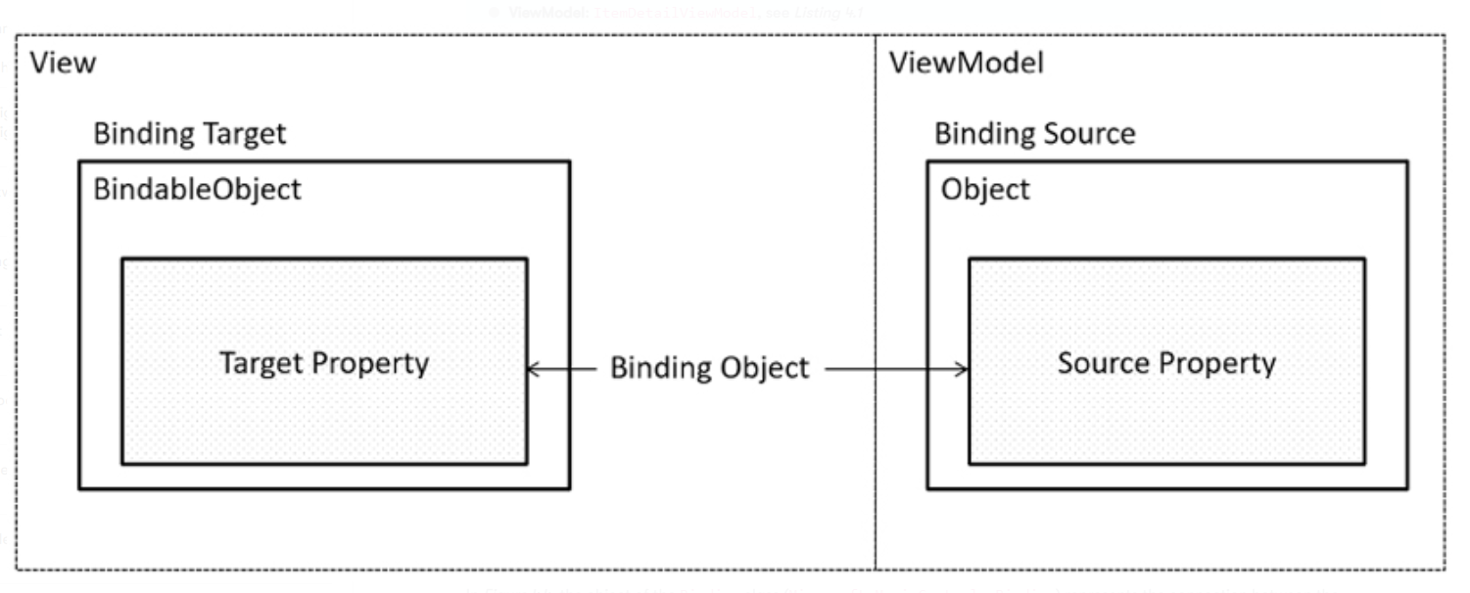
Data Binding Detail
Target – This is the UI element involved and this UI element has to be a child of BindableObject. The UI element used in ItemDetailPage is Label.
Target property – This is the property of the target object. It is a BindableProperty. If the target is Label, as we mentioned here, the target property can be the Text property of Label.
Source – This is the source object referenced by data binding. It is ItemDetailViewModel here.
Source object value path – This is the path to the value in the source object. Here, the path is a ViewModel property, such as Name or Description.

Slide 133
Using MVVM Community Toolkit
Use NuGet to add package to project
Add Using directives to code files
Utilize attributes to generate code with required event handling
ObservableObject
ObservableProperty
Relay Command

Slide 134
Create ViewModels
One ViewModel per View page
ViewModel class must have the “[Observable Object]” attribute
ViewModel classs must be “public” and “partial” for MVVM Community Toolkit
using CommunityToolkit.Mvvm.ComponentModel;
namespace ForgetMeNotDemo.ViewModel;
[ObservableObject]
public partial class MainViewModel
{
}

Slide 135
Data Binding in .Net MAUI MVVM
Create Binding Context in View code-behind file
Create a public properties in ViewModel to match each UI control
Add “[Observable Property]” attribute to each property
Camel Case property names – will generate Pascal Case in generated code
Bind View Control property to ViewModel property
e.g. Text="{Binding FullName}"
public partial class MainPage : ContentPage
{
private MainViewModel vm = new MainViewModel();
public MainPage()
{
InitializeComponent();
BindingContext = vm;
}
}
[ObservableProperty]
private string fullName;

Slide 136
ViewModel vs Code-Behind
Where should I put my code?
Lots of options, no absolute right answer
Recommendations:
“Initialize Component” call must be in Code-Behind
Set Binding Context in Code-Behind
Move Event Handlers to ViewModel

Slide 137
MAUI Controls (Views)
Images
Labels
Buttons
ImageButtons
Text
Entry – single line
Editor – multiple lines

Slide 138
Bind an Event
Use “[RelayCommand]” to generate bindable method in VM
Event handler name in View page must have “Command” at end of name
View
<Image
HeightRequest="200"
HorizontalOptions="Center"
IsVisible="{Binding FlowerIsVisible}"
Source="{Binding FavoriteFlower}"
x:Name="BigFlower" />
<Button
Text="Click me"
Command="{Binding ToggleFlowerVisibilityCommand}"/>
ViewModel
[ObservableProperty]
private bool flowerIsVisible = true;
[RelayCommand]
private void ToggleFlowerVisibility()
{
FlowerIsVisible = !FlowerIsVisible;
}

Slide 139
Binding to a Collection
Use “CollectionView” XAML control
Create a Service to populate collection from source (DB or Mock)
In VM, declare a variable to hold instance of Service
Instantiate Service in VM Constructor
Use VM “Init()” method to run Service method that populates data

Slide 140
Example 1 Collection ViewModel
public partial class MyViewModel : ObservableObject
{
public MyViewModel()
{
Students.Add(new Student
{
Id = 123,
Name = "John Doe",
IsRegistered = false
});
Students.Add(new Student
{
Id = 234,
Name = "Jane Doe",
IsRegistered = false
});
}
public ObservableCollection<Student> Students { get; } = new();
[RelayCommand]
void UpdateRegistrations()
{
foreach(var item in Students)
item.IsRegistered = true;
}
}

Slide 141
Example 1 Collection View
<ContentPage...>
<Grid
RowDefinitions="*,50">
<CollectionView
Grid.Row="0"
ItemsSource="{Binding Students}">
<CollectionView.ItemTemplate>
<DataTemplate
x:DataType="model:Student">
<Grid
ColumnDefinitions="*,30">
<Label
Grid.Column="0"
Text="{Binding Name}" />
<Image
Grid.Column="1"
Source="checkmark.png"
IsVisible="{Binding IsRegistered}" />
</Grid>
</DataTemplate>
</CollectionView.ItemTemplate>
</CollectionView>
<Button
Grid.Row="1"
Text="Update Data"
Command="{Binding UpdateRegistrationsCommand}" />
</Grid>
</ContentPage>

Slide 142
Example 2 Bindable Model Class
namespace ForgetMeNotDemo.Model;
[ObservableObject]
public partial class Preference
{
[ObservableProperty] private string preferencePrompt;
[ObservableProperty] private string preferenceValue;
}

Slide 143
3 Syntaxes to Instantiate a Class
1.
CreditCourse myCreditCourse = new CreditCourse();
2.
var myCreditCourse = new CreditCourse();
3.
CreditCourse myCreditCourse = new() ;

Slide 144
Example Code
Declare an instance of PreferenceService
Initialize it in the constructor
In the Init method, fill the Preferences collection with what you get back from the service
[ObservableObject]
public partial class PreferencesViewModel
{
[ObservableProperty] private List<Preference>
preferences;
private readonly PreferenceService service; [1]
public PreferencesViewModel()
{
service = new(); [2]
}
public async Task Init()
{
Preferences = await service.GetPreferences(); [3]
}
}

Slide 145
Behaviors
Allow you to add functionality to Controls without creating Event Handler
EventToCommand behavior from MVVM Community Toolkit
Converts an Event (handled in Code-Behind) into a Command (handled in ViewModel)

Slide 146
Brushes – Styling in XAML
Solid
Linear Gradient
Radial Gradient

Slide 147
Development Security
Application Security
Runtime Security
Dev Environment Security

Slide 148
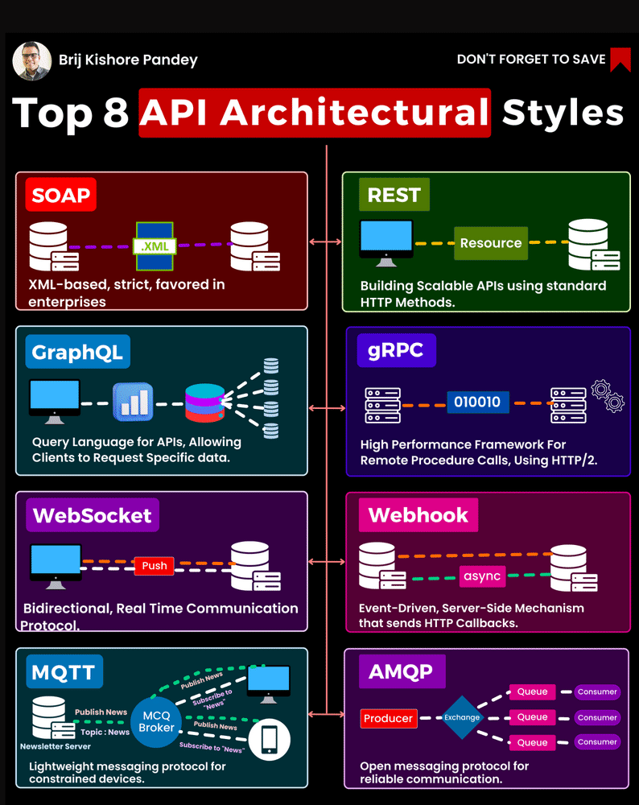
https://www.devopsschool.com/blog/top-api-architectural-styles/

Slide 149
Resources

Slide 150
C# Resources
C# Tutorial (C Sharp) (w3schools.com)
C# Coding Conventions - C# Programming Guide | Microsoft Docs
Visual Studio IDE, Code Editor, Azure DevOps, & App Center - Visual Studio (microsoft.com)
.NET | Free. Cross-platform. Open Source. (microsoft.com)
.NET developer community | Connect with like-minded developers (microsoft.com)
.NET API browser | Microsoft Docs
C# Fundamentals for Absolute Beginners | Channel 9 (msdn.com)
Free ebooks for .NET & JavaScript Developers | Syncfusion
Amazon.com: Rockin the C# Interview: 2017 Edition: A comprehensive question and answer reference guide for the C# programming language. eBook: Unger, Greg: Kindle Store
Learning C# by Developing Games with Unity 2020 - Fifth Edition | Packt (packtpub.com)
https://www.dotnetcurry.com/

Slide 151
C# Tutorials
.NET In-Browser Tutorial - Step 1: Intro (microsoft.com)
Introduction to C# - interactive tutorials | Microsoft Docs
https://docs.microsoft.com/en-us/dotnet/core/tutorials/with-visual-studio
https://docs.microsoft.com/en-us/dotnet/core/tutorials/with-visual-studio-code
350+ C# Practice Exercises // Edabit

Slide 152
Sunset of the IDEs
DEVOPS
e.g. VS Code
IDE
e.g. Visual Studio
Code run in an environment that is “sort of” like production
Code run and tested in environment identical to production

Slide 153
Assignment 3.2 Determine Quadrant
Y
(-X,+Y)
(+X,+Y)
Second
First
X
(-X,-Y)
(+X,-Y)
Third
Fourth

Slide 154
WinForms
Window
Button
Label:
Text Box

Slide 155
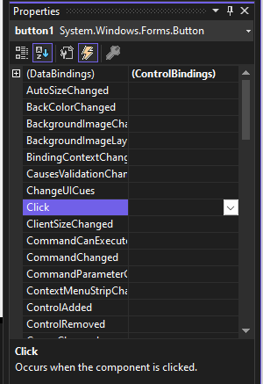
Event Handling
Window
Button1
Code-Behind Page
private void button1_Click(object sender, System.EventArgs e)
{
//Do Something
}
https://learn.microsoft.com/en-us/dotnet/desktop/winforms/event-handlers-overview-windows-forms?view=netframeworkdesktop-4.8
https://learn.microsoft.com/en-us/previous-versions/visualstudio/visual-studio-2010/zwwsdtbk(v=vs.100)

Slide 156
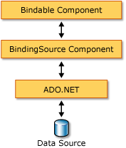
Data Binding - Simple
Window
Label:
Text Box
Variable
or
Property of Object

Slide 157
Data Binding - Dynamic
Window
Label:
Text Box
Variable
or
Property of Object

Slide 158
Data Binding - Dynamic
Window
Label:
DataGridView
Collection:
ArrayList
List
Dictionary

Slide 159
Data Binding - Resources
https://stackoverflow.com/questions/16695885/binding-listt-to-datagridview-in-winform
class Person
{ public string Name {get; set;}
public string Surname {get; set;}
}
var list = new List<Person>()
{ new Person { Name = "Joe", }, new Person { Name = "Misha", }, };
var bindingList = new BindingList<Person>(list);
var source = new BindingSource(bindingList, null);
grid.DataSource = source;
Data Grid
https://learn.microsoft.com/en-us/dotnet/desktop/winforms/controls/datagridview-control-overview-windows-forms?view=netframeworkdesktop-4.8
Binding Source
https://learn.microsoft.com/en-us/dotnet/desktop/winforms/controls/bindingsource-component-overview?view=netframeworkdesktop-4.8

